Slide 1

Indexed Tag-Based Knowledge Retrieval System
MALLA REDDY COLLEGE OF ENGINEERING & TECHNOLOGY
(Autonomous Institution– UGC, Govt. of India)
Sponsored by CMREducational Society (Affiliated to JNTU, Hyderabad, Approved by AICTE- Accredited by NBA& NAAC– ‘A’ Grade- ISO 9001:2015 Certified) Maisammaguda,Dhulapally (PostVia Hakimpet), Secunderabad– 500100,TelanganaState,India. ContactNumber:040-23792146/64634237,E-MailID:mrcet2004@gmail.com , website: www.mrcet.ac.in
Batch D6 Shaik Afroz -22N31A05M3 S.Akshara -22N31A05N7 T.Siva Rama Krishna -22N31A05P7
Under the esteemed guidance of Dr. M Sambasivudu
Associate Professor

Slide 2
Abstract
Managing personal knowledge in the form of notes, diagrams, and reference links often becomes inefficient as the volume of information grows. Existing tools either rely on simple keyword searches or introduce unnecessary complexity that reduces usability. This project presents a low-latency knowledge storage and retrieval system that organizes content using indexed tags and supports intuitive querying.
The system allows users to store different types of content locally and retrieve them instantly through tag-based searches. An indexed backend ensures fast query execution, while optional caching improves response time for frequently accessed data. The platform follows a modular and local-first architecture, making it suitable for self-hosted usage without dependency on cloud services. The project emphasizes clean system design, performance optimization, and practical usefulness over advanced machine learning or heavy research components.

Slide 3
Introduction
The project focuses on building a personal knowledge system that enables fast and reliable retrieval of notes, images, and links using indexed tags. Instead of relying on simple text matching or manual browsing, the system preprocesses and indexes user-defined tags to allow efficient lookup. The emphasis is on low latency, modular backend design, and practical usability rather than complex artificial intelligence techniques. The system is designed to be self-hosted, lightweight, and usable across multiple interfaces such as a web client and chat-based bots.

Slide 4
Existing System
Most existing note-taking and knowledge management systems fall into one of the following categories:
1. Simple File-Based Storage:
Notes and files are stored in directories with manual naming and folder hierarchies. Retrieval depends on memory or manual searching, which becomes inefficient over time.
2. Keyword-Based Search Systems
Many applications rely on basic text or regex-based search. These approaches perform full scans at query time, resulting in slower response times as data grows.
3. Over-Complex Cloud Platforms
Some tools introduce unnecessary features such as heavy synchronization, proprietary formats, or cloud lock-in, making them unsuitable for personal, offline-first usage.
These systems either lack performance, flexibility, or transparency, especially for users who want fast access to their own curated knowledge without external dependencies.

Slide 5
Proposed System
Tag-Based Indexing: Each item is associated with tags for direct and fast retrieval
Flexible Organization: Supports multiple tags per item, eliminating folder limitations
Multi-Content Support: Stores notes, images, and links in a unified structure
Fast Retrieval: Uses precomputed indexes to avoid full database scans
Caching Mechanism: Frequently accessed data stored in memory for quick response
Local-First Design: Ensures data privacy, control, and offline accessibility
Modular Architecture: Separate components for indexing, search, caching, and storage
High Performance: Low latency, scalable, and efficient system design

Slide 6
Hardware & Software Requirements:
Hardware Requirements
• Minimum 8 GB RAM
• 10 GB free disk space
• Standard x86 or ARM-based system
• Internet connection (optional, for bot integration)
Software Requirements
• Operating System: Linux / Windows / macOS
• Backend Framework: FastAPI (Python)
• Database: PostgreSQL
• Cache: Redis
• Containerization: Docker and Docker Compose
• Client: Web browser / Telegram or Discord client

Slide 7
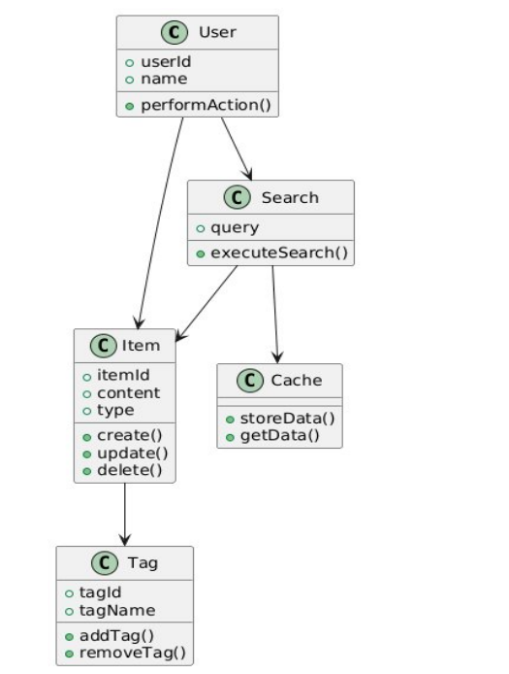
Class Diagram

Slide 8
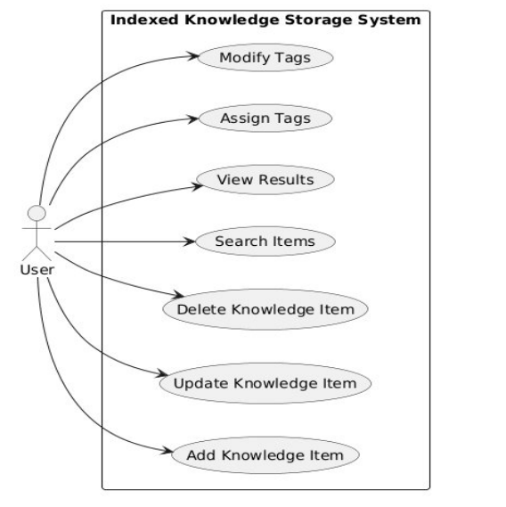
Use Case Diagram

Slide 9
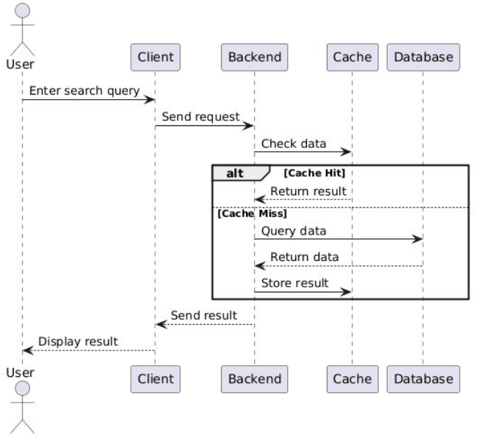
Sequence Diagram

Slide 10
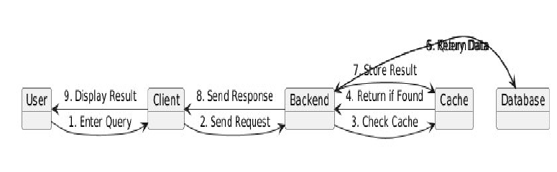
Collaboration Diagram

Slide 11
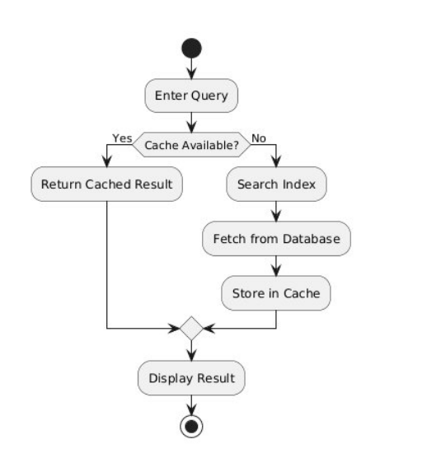
Activity Diagram

Slide 12
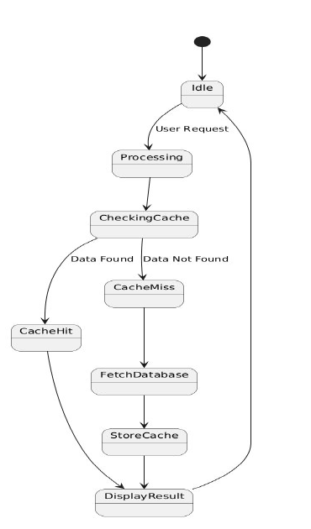
State chart Diagram

Slide 13
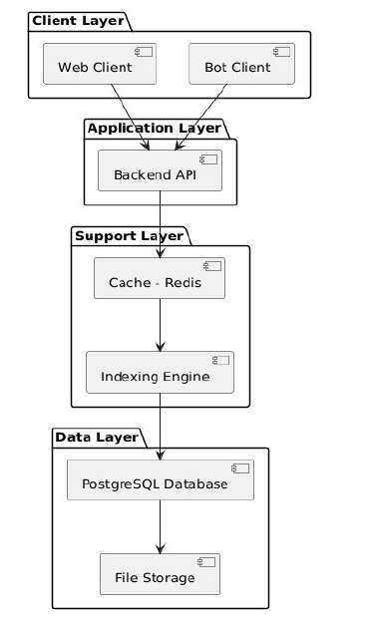
Component Diagram

Slide 14
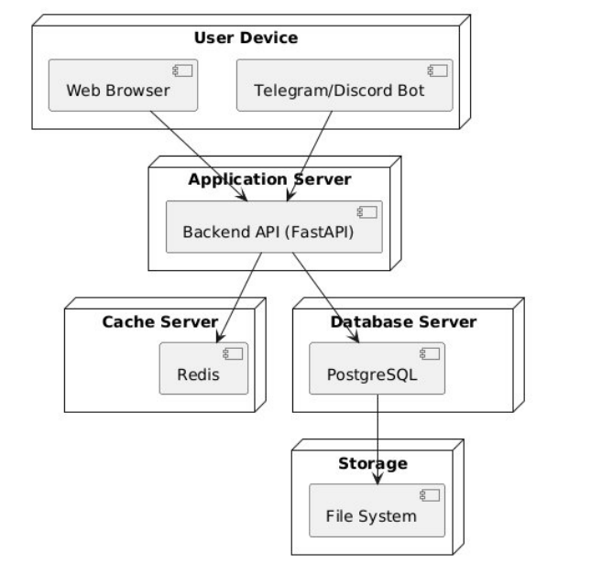
Deployment Diagram

